Slide 1
House Sales Price Prediction
author: Parviz Hajizada

Slide 2
Introduction
Source: Kaggle
Data: House Sales in King County, USA
Target variable: Price

Slide 3
Exploratory Data Analysis
No missing value
Both numerical and categorical features

Slide 4
Feature Engineering
We have a year_renovated column indicating when the house has been renovated if ever, but 96% of houses have never been renovated, so we creature a dummy variable to show if a house has ever been renovated and drop the year_renovated column.
We have another column called year which depicts the year at which the house is sold but we drop it because the dataset covers only 2 years which is too little and also if we included the year then we could make only in-sample prediction. Instead we will use month column which would account for seasonal price change.

Slide 5
Data preprocessing
Bedrooms column
Number of houses with 7 or more bedrooms are quite little such that we will aggregate them under 6+ bedrooms level.
Bathrooms column
Number of houses with 3.75 or more bathrooms will be aggregated under 3.5+ level.
Floors column
Number of houses with 2.5 or more floors will be aggregated under 2+ level.
etc...

Slide 6
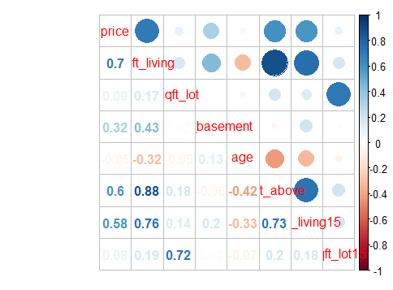
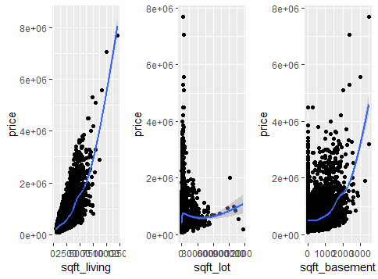
Back to Exploratory Data Analysis
Correlation
Most correlated variables with price

Slide 7
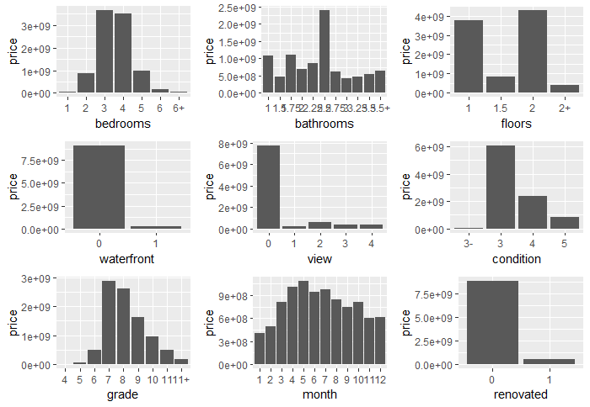
Back to Exploratory Data Analysis 2

Slide 8
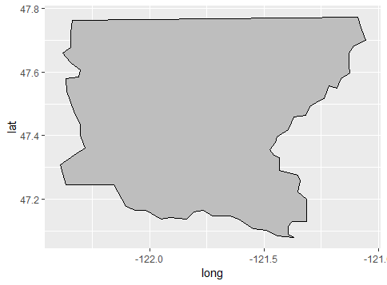
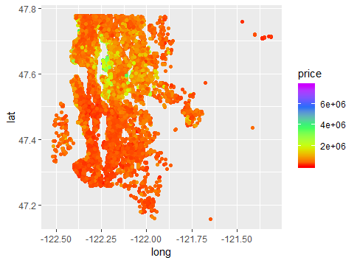
Map of King County and heat map of prices

Slide 9
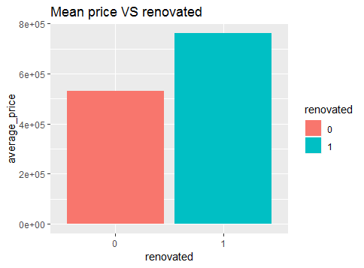
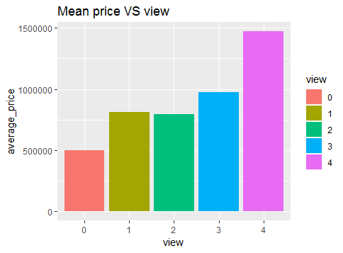
Mean price against Renovated
Mean price against View

Slide 10
List of models used
Linear Regression
Linear Support Vector Machines
Radial Support Vector Machines
Treebag
Bayesian Generalized Linear Models
Classification and Regression Trees

Slide 11
Results
 | RMSE | Rsquared | MAE
lm | 1.488733e+05 | 8.296537e-01 | 8.981330e+04
svm_linear | 1.513252e+05 | 8.279697e-01 | 8.291942e+04
svm_radial | 2.634224e+05 | 4.849898e-01 | 1.342765e+05
treebag | 2.246180e+05 | 6.091055e-01 | 1.568402e+05
bayesglm | 1.488737e+05 | 8.296501e-01 | 8.981299e+04
cart | 2.430796e+05 | 5.481711e-01 | 1.650317e+05

